Slide 1
AML training
Notes:
(pause: 2)
Welcome to our corporate Anti Money Laundry training session. This video is part of your mandatory employee onboarding.
Our company is required by the regulatory framework to put in place checks to prevent the facilitation of movement of illegal transactions.
All employees must familiarize themselves with the process of money laundering, which the criminal businesses use to disguise the true origin and ownership of illegal cash.

Slide 2

What is money laundering?
Notes:
Money laundering is the process of making illegally-gained proceeds appear legal. Criminals use money laundering to conceal their crimes and the money derived from them.

Slide 3
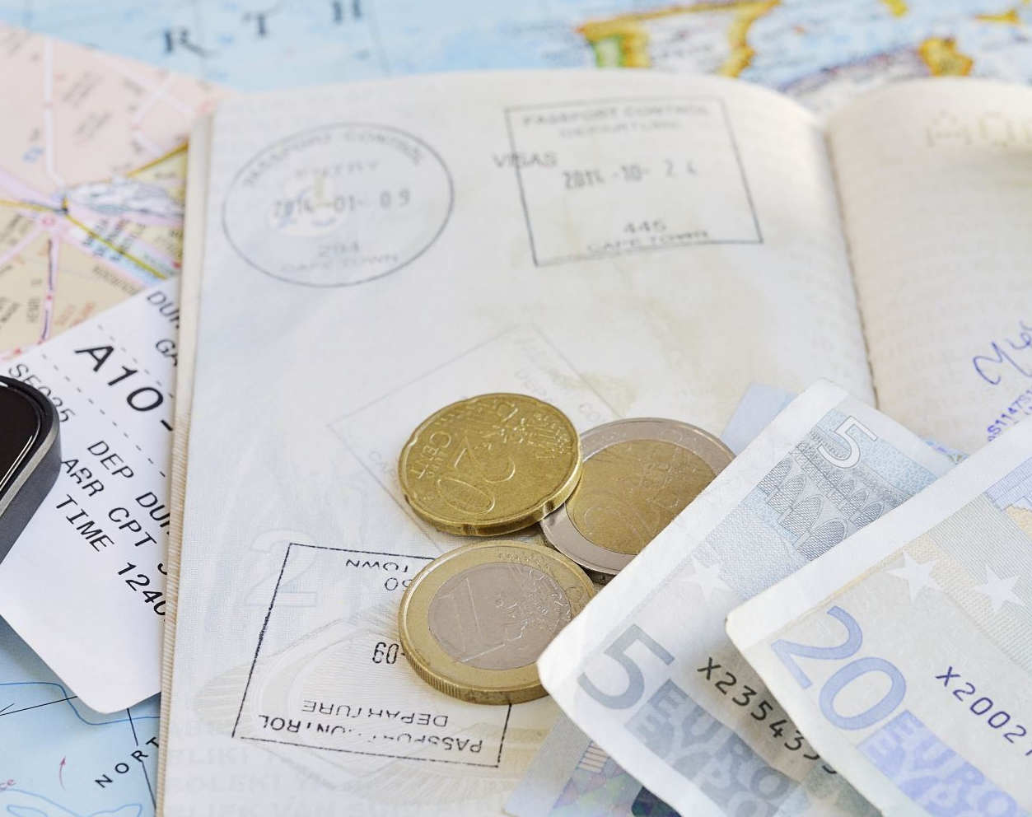
Using legitimate cash-based businesses
Notes:
One common technique is to facilitate the flow of money through a legitimate cash-based business, typically owned by affiliates of a criminal organization. The supposedly legitimate business brings the money into the legal banking system, deposits the money as income, which the criminals can then transfer or withdraw.

Slide 4

Hiding income
Foreign transfers
Smaller deposits
Buying cash-equivalent instruments
Investing
Notes:
There are several ways transfers are disguised to avoid suspicion, including
Transfers to foreign countries
(pause: 0.5)
Depositing cash in smaller increments
(pause: 0.5)
Buying other cash-equivalent instruments
(pause: 0.5)
Another common technique is for launderers to invest the money, using dishonest brokers who are willing to ignore the rules in return for large commissions.
Our company is not like that.

Slide 5
Quick test: Is the following statement true or false?
Notes:
(pause: 1)
The next slide contains a statement. You will have two seconds to think about it, and evaluate if it is true or false.

Slide 6

Money laundering is the concealment of the origins of illegally obtained money.
Notes:
Money laundering is the concealment of the origins of illegally obtained money.
(pause: 2)
(sound: ding400)

Slide 7
True!
Notes:
The statement was true!

Slide 8

Conducting customer due diligence (CDD)
Notes:
In this section, we will look into an important process to prevent money laundering, customer due diligence.
Customer due diligence is the process of identifying your clients and checking they are who they say they are.

Slide 9
Customer due diligence is the process of identifying your clients and checking they are who they say they are.
Risk assessment: you must conduct a risk assessment on each client, considering:
Customer risk
Product risk
Service risk
Geographical risk
Risk categorization: determines which level of due diligence to perform. Potential categories:
low,
medium or
high risk
Notes:
When you onboard a client, you will need to request certain documents, and then you or your staff should review them. You must advise your staff of any red flags, for example if the client is being evasive.
Why it CDD important?
Criminals try to mask their true identity, by providing fraudulent documents or using complex ownership structures. The purpose of this process is to know a client's identity and understand their business activities, so you can properly manage money laundering risks.
You must understand normal practice in order to detect abnormal events and red flags.
You must perform a risk assessment in the following categories:
Customer risk: What do they do? Is there business cash intensive?
If they sell a product, is it high risk?
If they provide a service, do they usually do it remotely, without meeting their clients?
Will they receive payments from third parties?
Is the client based in a high-risk jurisdiction?
Once you complete the assessment, our company will categorize the client into low, medium or high risk. This risk categorization determines which level of due diligence is required to onboard the client.

Slide 10

Sample scenarios
Notes:
In the following section, you will need to review some client profiles and determine their risk. Would you classify them as high, medium or low risk?
You will have 3 seconds for each scenario.

Slide 11
Sunshine Spa
Located in East Village
No internet site
3 Yelp reviews
Open from 5PM to 2AM
No social media accounts
Notes:
Consider this client profile.
A massage parlour is located in the East Village neighbourhood of New York, mostly dealing with cash. They are open during the week days from 5PM to 2AM, and do not have any visible internet presence. No web site, no social media accounts. While researching the vicinity, you discover several news articles about arrests from raids on prostitution rings run from ‘massage parlours’, but the client you are onboarding was not named in any reports.
Would you classify them as high, medium or low risk? Why? You have 3 seconds.
(pause: 3)
(sound: ding400)

Slide 12
High risk
Notes:
The correct answer is High Risk.
This is a cash-intensive business, which automatically requires more scrutiny.
Having no website is odd for a legitimate business today.
The operating hours are unusual.

Slide 13
Brandy Logos
Design agency
Based in New Jearsey
5 year old business
Single owner
Mostly corporate clients
Good web presence
Notes:
Consider the next profile.
A small design agency, with a sole director and beneficial owner. The business has been trading for five years, with mostly corporate clients, and electronic payments. Their profits are in line with industry statistics.
Would you classify them as high, medium or low risk? Why? You have 5 seconds.
(pause: 5)
(sound: ding400)

Slide 14
Medium risk
Notes:
The correct answer is Medium Risk.
The business is not cash-intensive, and the structure is simple. The company has operated for several years without raising red flags.
Why not low risk? Refer to ‘Low-risk factors’ within appendix Z of the AML guidance.

Slide 15
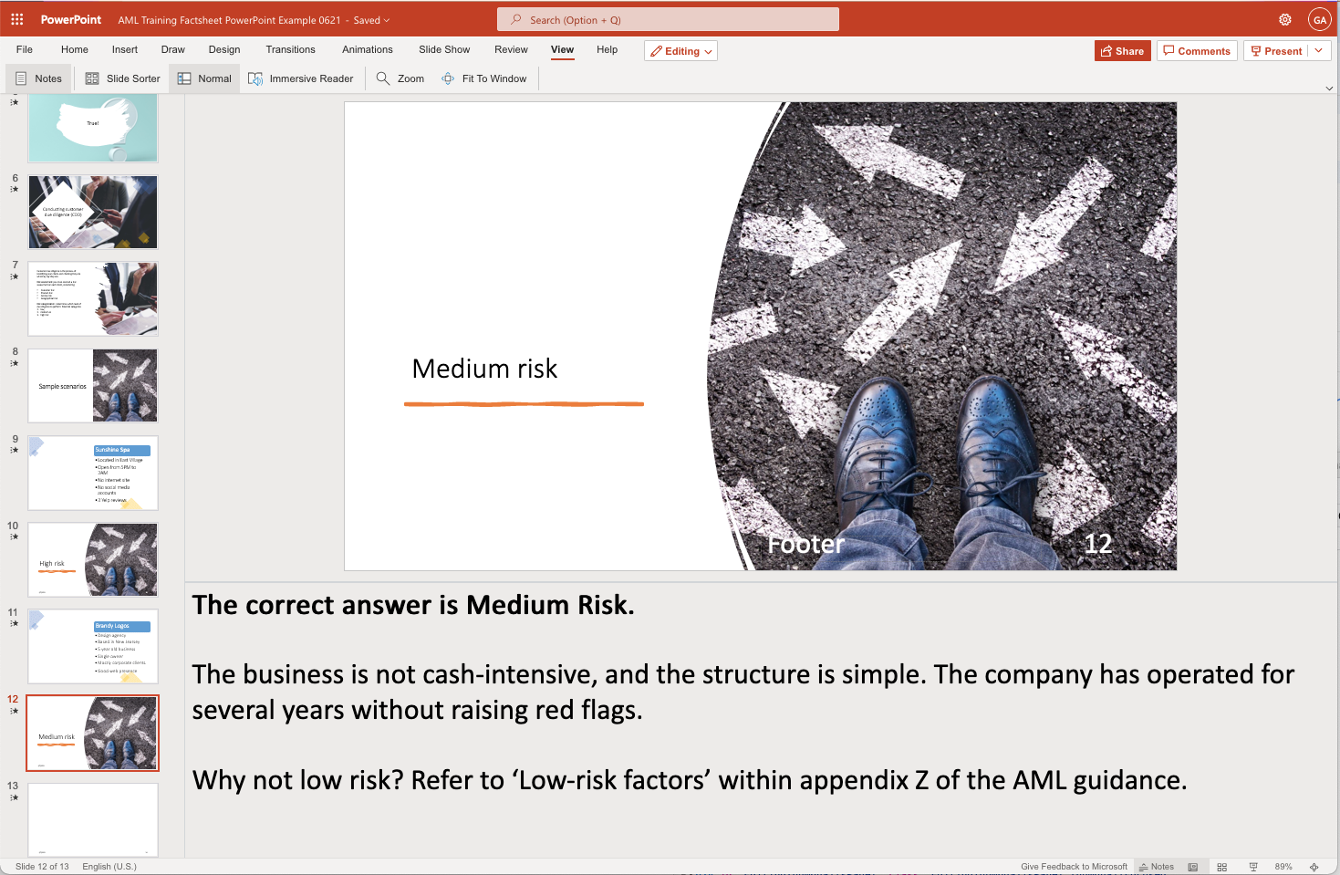
Notes:
(voice: rodney)
Create corporate training videos like this one easily using Narakeet.
Add voice over text to speaker notes and upload a Powerpoint file to turn it into a narrated video in minutes.
The video you are watching now was created using a Powerpoint presentation and Narakeet text to speech voices.

Slide 16

Narakeet.com
Notes:
(voice: rodney)
For more information, check out Narakeet.com

