Slide 1

User Persona Research
Prepared for Total Concerts
by UX Research Associates
Notes:
(pause: 1)
Thank you for engaging UX Research Associates. It was a pleasure to help Total Concerts in understanding your audience. This is a video-report of our research.

Slide 2
Our Methodology
Surveyed 7 thousand Total Concerts web site users
Grouped into 4 key categories
Selected 200 for in-depth interviews
Identified core needs/wants/expectations
Notes:
First, a few notes on our methodology. To be truly customer-driven, you need to understand who your customers are. Using the website contact form, we surveyed 7 thousand users during two weeks, inquiring about their preferences and needs. This first stage of the research was focused on predefined questions. This allowed us to get a broader understanding of your audience, and select a smaller representative group for in-depth interviews. We then conducted 200 live video sessions, asking open-ended questions for deep understanding. By identifying actual core needs and expectations of the users, we were able to group them into four distinct categories.

Slide 3
Hanna
"frequent traveler"
Age: 30-40
Income:
>100K EUR
Tech proficiency: Medium - High
Notes:
The first group is best illustrated by a persona of a frequent traveler. We called her Hanna. Hanna is middle-aged. She is a senior leader at a company, visiting different cities for business trips. She is not an IT expert, but knows how to use mobile devices and technology easily. Hanna has a lot of disposable income, but lacks time.

Slide 4
Hanna
Motivated by: Experiencing local culture when travelling, avoiding boredom
Event Attendance: Goes to 2-3 concerts per month, usually when travelling for business and staying somewhere over the weekend
Pain points: Discovering local events to fit in with her schedule, planning in the last minute.
Notes:
When visiting various business locations, Hanna is going out primarily as a way to experience local culture. She does not care too much about a specific band or type of music, but instead wants to avoid boredom, and looks for authentic experiences. Her main pain point is last-minute planning. She needs to quickly discover relevant local events to fit into her busy schedule.

Slide 5
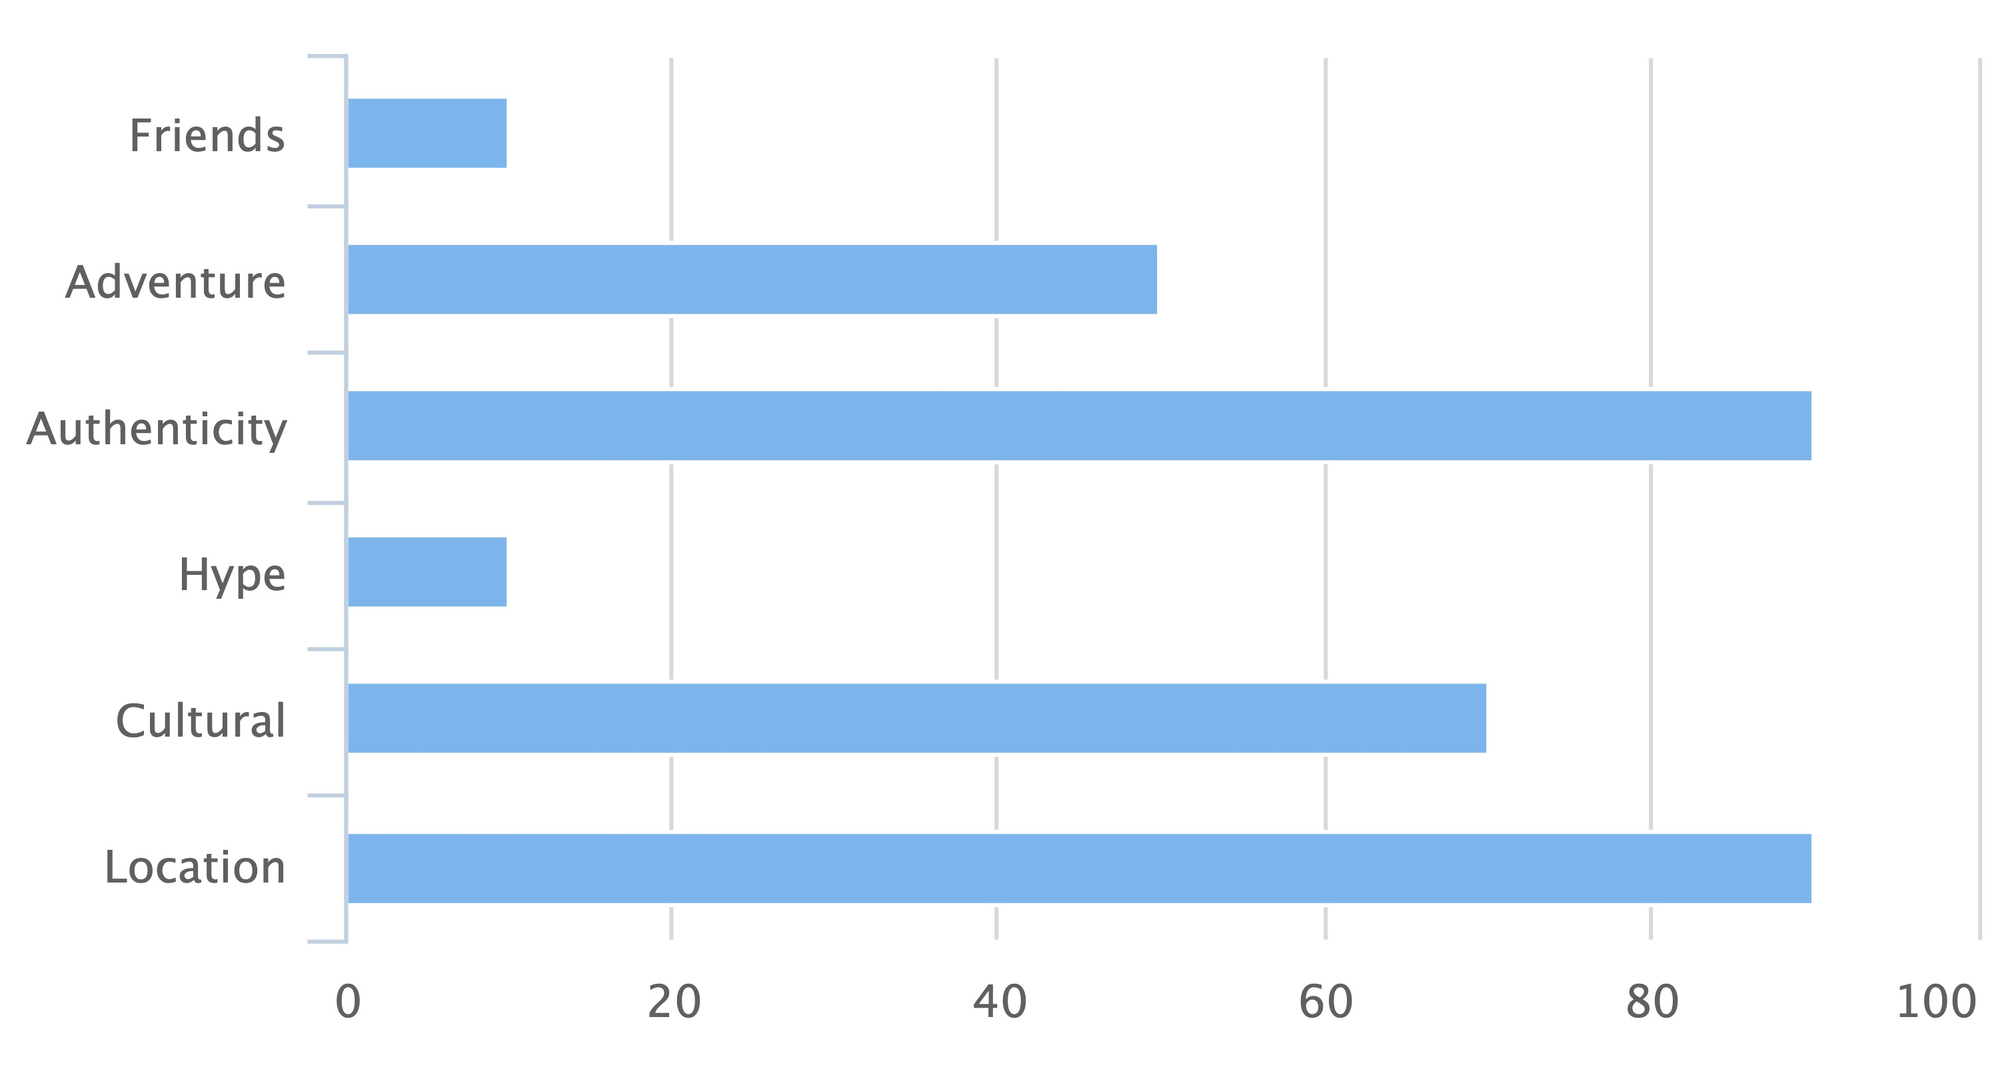
Hanna
Notes:
From the broad survey of users that match this persona, authenticity and location are the main criteria for selecting concerts. Hype and friends are the least important.

Slide 6
Rolf
"Festival Junkie"
Age: 15-25
Income: <50K EUR
Tech proficiency: Medium - High
Notes:
The second persona is what we called a festival junkie. We named him Rolf. Rolf is relatively young, and very proficient with technology, but does not have a lot of disposable income. Rolf is typically a high-school student, whose parents are paying for concert visits and travel, or a student with some disposable income coming from part-time work.

Slide 7
Rolf
Motivated by: Hanging out with friends, having a great experience, social aspects.
Event Attendance: Goes to 4-5 big summer festival with friends, and smaller local parties throughout the year.
Pain points: Budget, planning travel
Notes:
Rolf usually only goes to local events to save money, but will travel to attend the major summer festivals. Rolf's main issue is lack of funds. Organizing travel, especially longer journeys, requires careful comparison of all the different options. Rolf might travel somewhere a day or two in advance to get cheap tickets, or might go to a nearby airport and take a bus to reach his final destination. With a lot of time, and not enough money, Rolf can turn such travel into a social experience with friends.

Slide 8
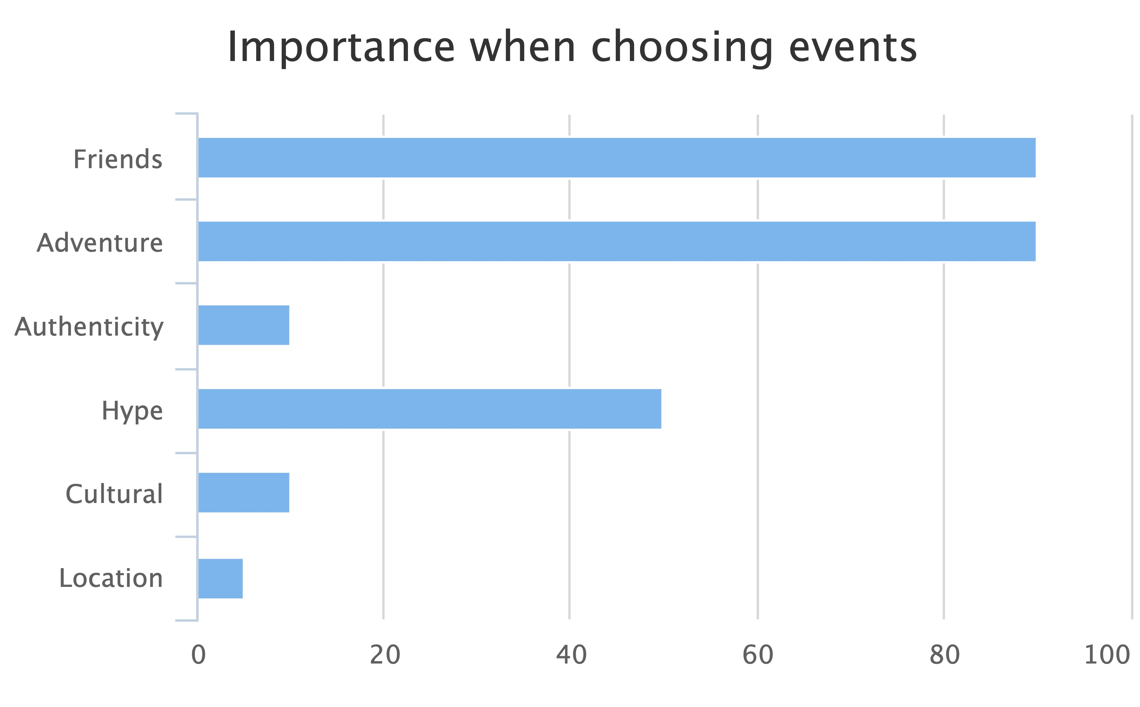
Rolf
Notes:
From the broader survey of users matching the Rolf persona, the key motivators are social experiences and adventure. Rolf doesn't care too much about authenticity or the location of events.

Slide 9
Monika
"Careful planner"
Age: 25-35
Income:
50-75K EUR
Tech proficiency: Medium - High
Notes:
The third major category is called Monika. Her age is between Rolf and Hanna. She has a young family, which takes priority over work. If employed, she is likely a middle-manager. Her disposable income is also between Hanna and Rolf. She has enough money to spend on the right events occasionally.

Slide 10
Monika
Motivated by: High-quality experiences, planning together within her social group.
Event Attendance: Goes to a small number of events (1-2 per month), but plans a lot in advance, willing to travel for the right event
Pain points: Fitting into everyone's schedule/budget, events selling out quickly.
Notes:
The major motivator for Monika is making good use of her time and money. She can only afford to go to a small number of events, due to family obligations and financial constraints, and this requires a lot of planning in advance. Monika typically goes to concerts with her social circle, composed mostly of people matching the same persona, so this complicates planning.

Slide 11
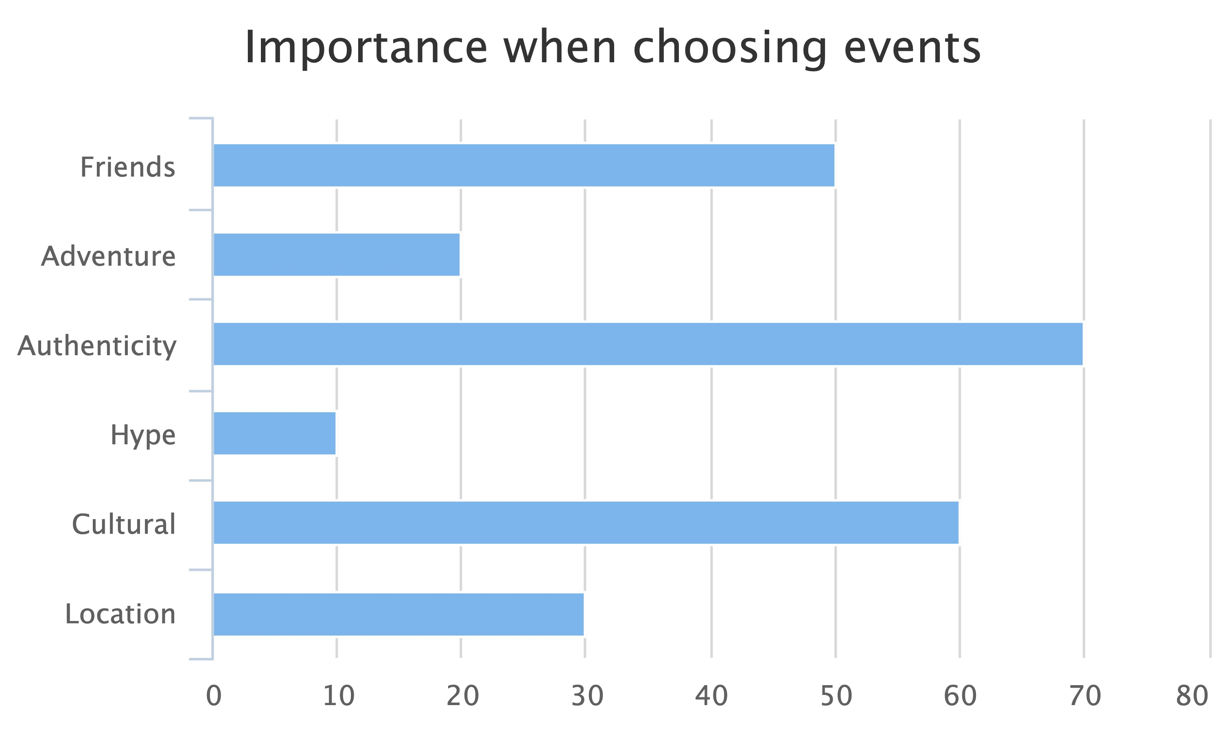
Monika
Notes:
The biggest motivational factor for Monika is to have a high-quality experience with her social group. She is looking for a big return on investment, both in terms of time and money. Authenticity, friends, and cultural drivers are critical. Location is also important, in the sense that nearby events are a lot easier to attend.

Slide 12
Thomas
"Influencer"
Age: 25-35
Income:
40-60K EUR
Tech proficiency: High
Notes:
The final persona is Thomas, a social influencer. Usually very handy with technology, Thomas is in the publicity business – either formally as a YouTube or Instagram businessperson, or informally as a social networker among friends. Although some users matching this persona make their income from social media advertising, that is a minority. The majority have a day job, which finances their lifestyle. Thomas is usually an office worker, but not a manager, and not climbing the corporate ladder.

Slide 13
Thomas
Motivated by: Networking, being the first to know experience, fear of missing out.
Event Attendance: Frequently goes to local events, travels only for big occasions
Pain points: Finding the time to attend everything and staying on budget. Missing out on trending events.
Notes:
This persona likes attending lots of events, and their major fear is missing out on something trending. They need to know about what's cool and what's not. Without a lot of disposable income, managing the budget to attend a large number of events is critical.

Slide 14
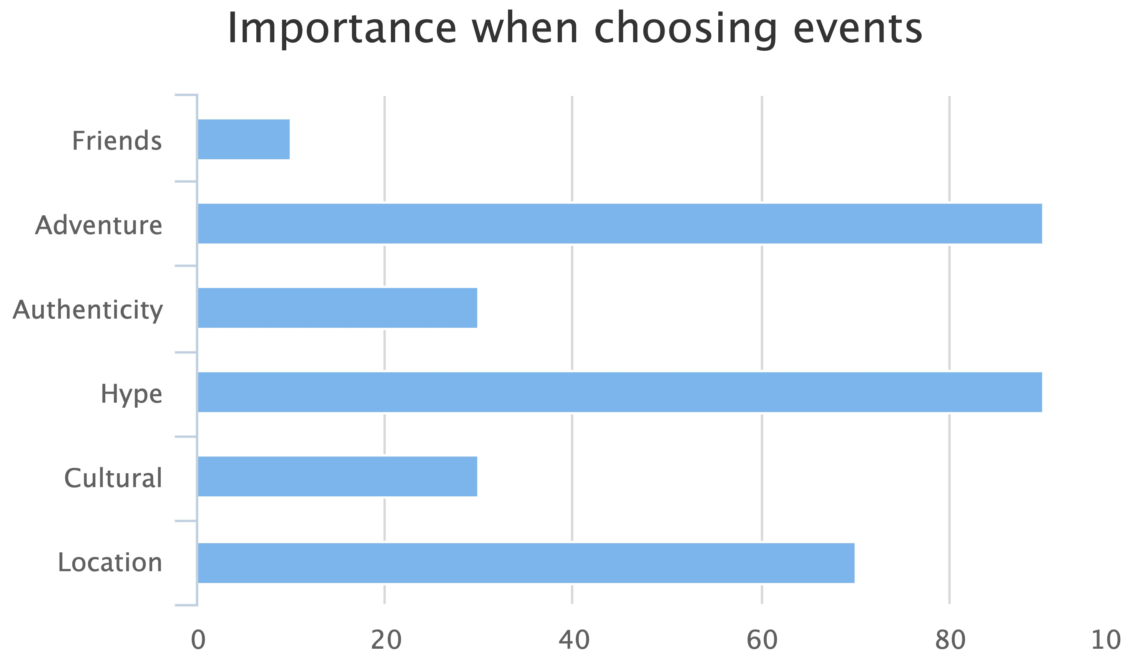
Thomas
Notes:
From the broad survey, adventure and hype are the key drivers for this persona. Location is the third most important aspect, as Thomas likely goes mostly to local events.

Slide 15
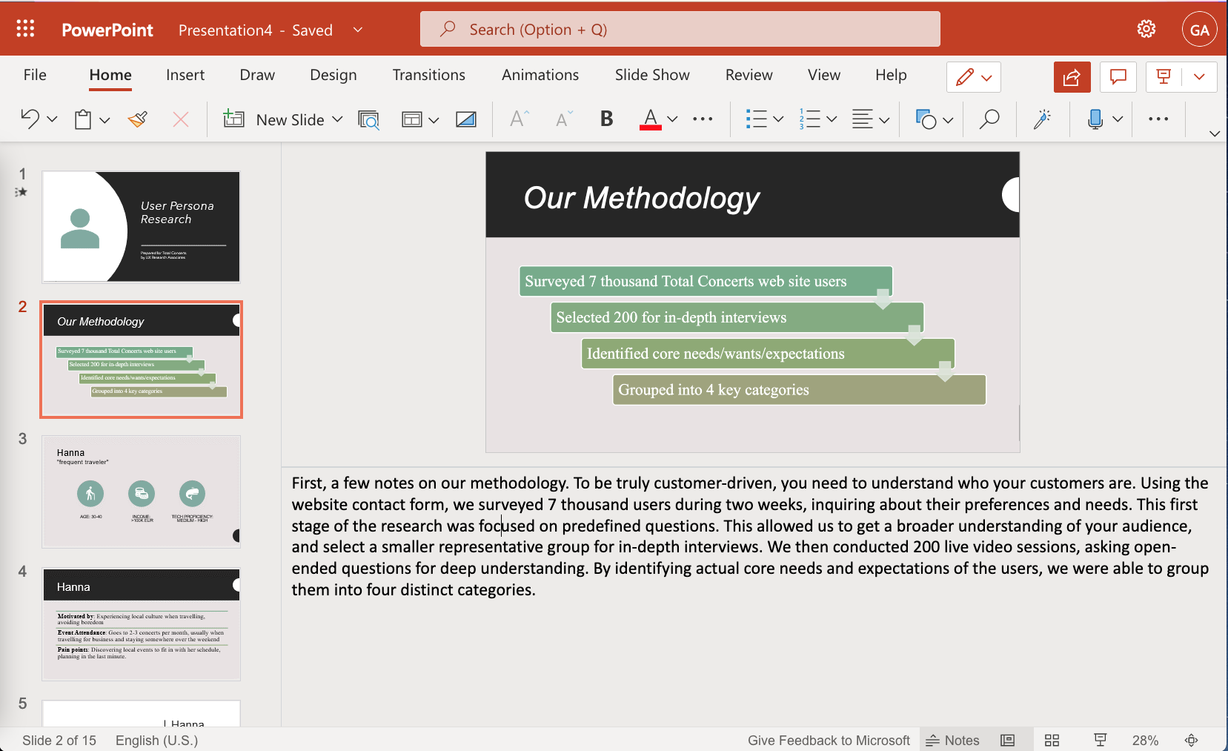
Notes:
(voice: rodney)
(pause: 0.5)
Create videos like this one easily using Narakeet. Just type the narration text into the speaker notes, and use our natural text to speech voices to quickly produce the voiceover.

Slide 16

www.narakeet.com
Notes:
(voice: rodney)
For more information, check out narakeet.com
(pause: 1)

