Slide 1
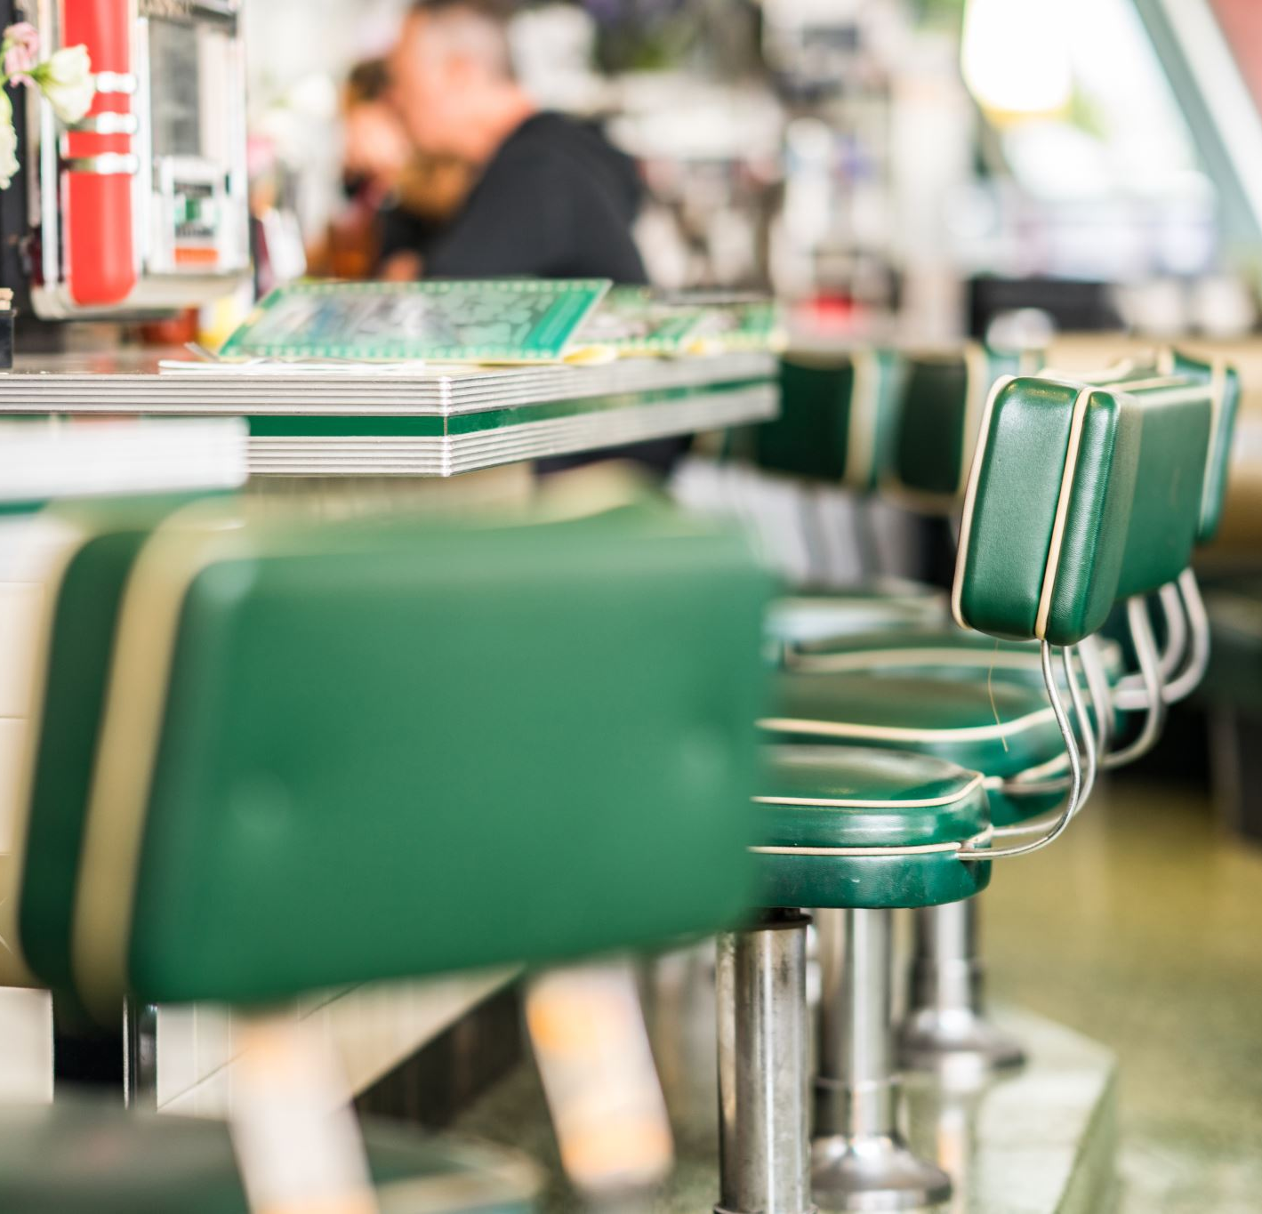



¡A comer!
Easy Spanish Lesson
Made with Narakeet
Notes:
(duration: 2)

Slide 2
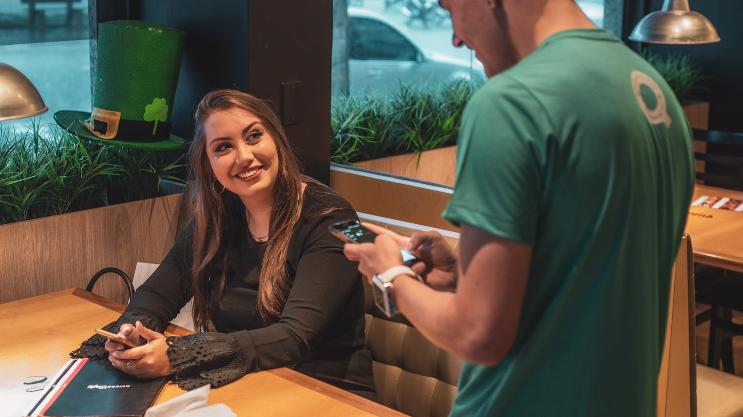
Notes:
(voice: Karen)
**Hi there!**
(voice: Enrique)
¡Hola! ¿Qué vas a tomar?
(voice: Karen)
(narration-mode: fragment)
I would like...

Slide 3
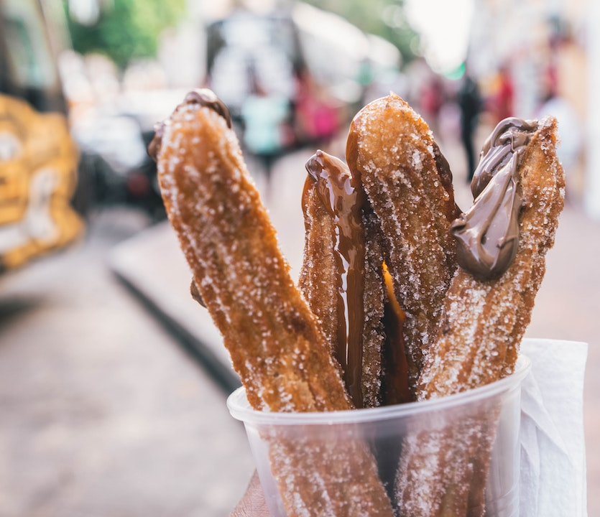
Notes:
(voice: Karen)
**This!**
(voice: Enrique)
Ah, ¿churros con chocolate? Aquí tienes. Son muy ricos.
(voice: Karen)
Ricos? I don’t understand?

Slide 4
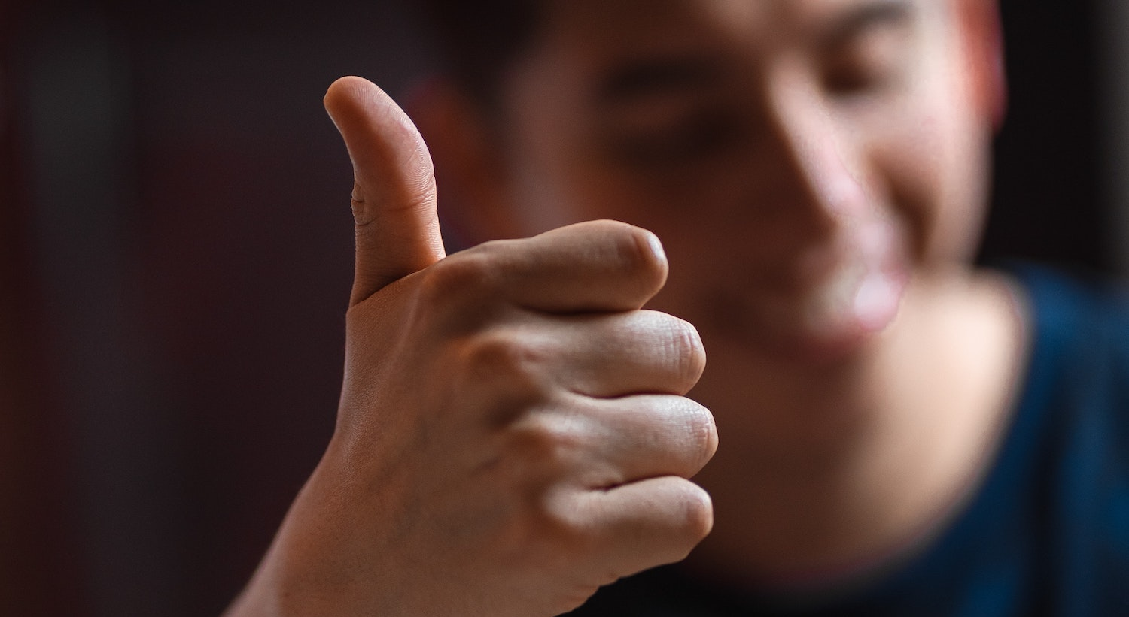
Notes:
(voice: Enrique)
Muy deliciosos.
(voice: Karen)
Perfect.

Slide 5
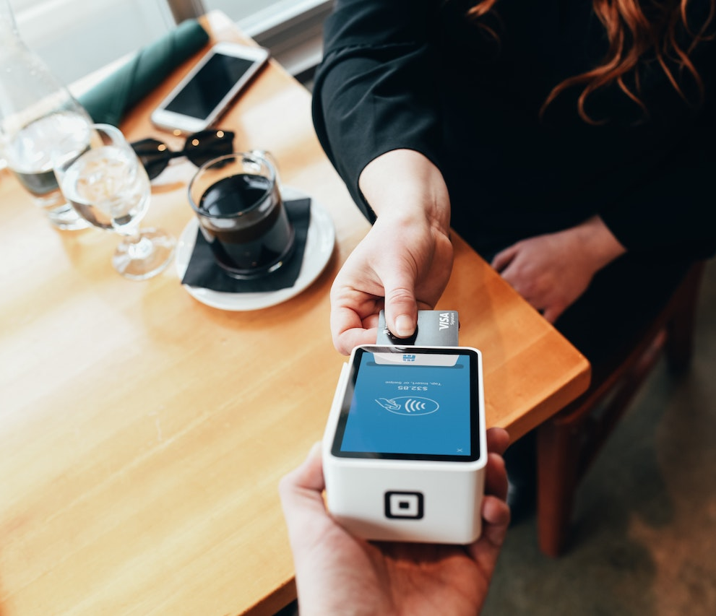
Notes:
(voice: Enrique)
Perfecto. Son €3.
(voice: Karen)
Here you are.
(pause: 1)

Slide 6
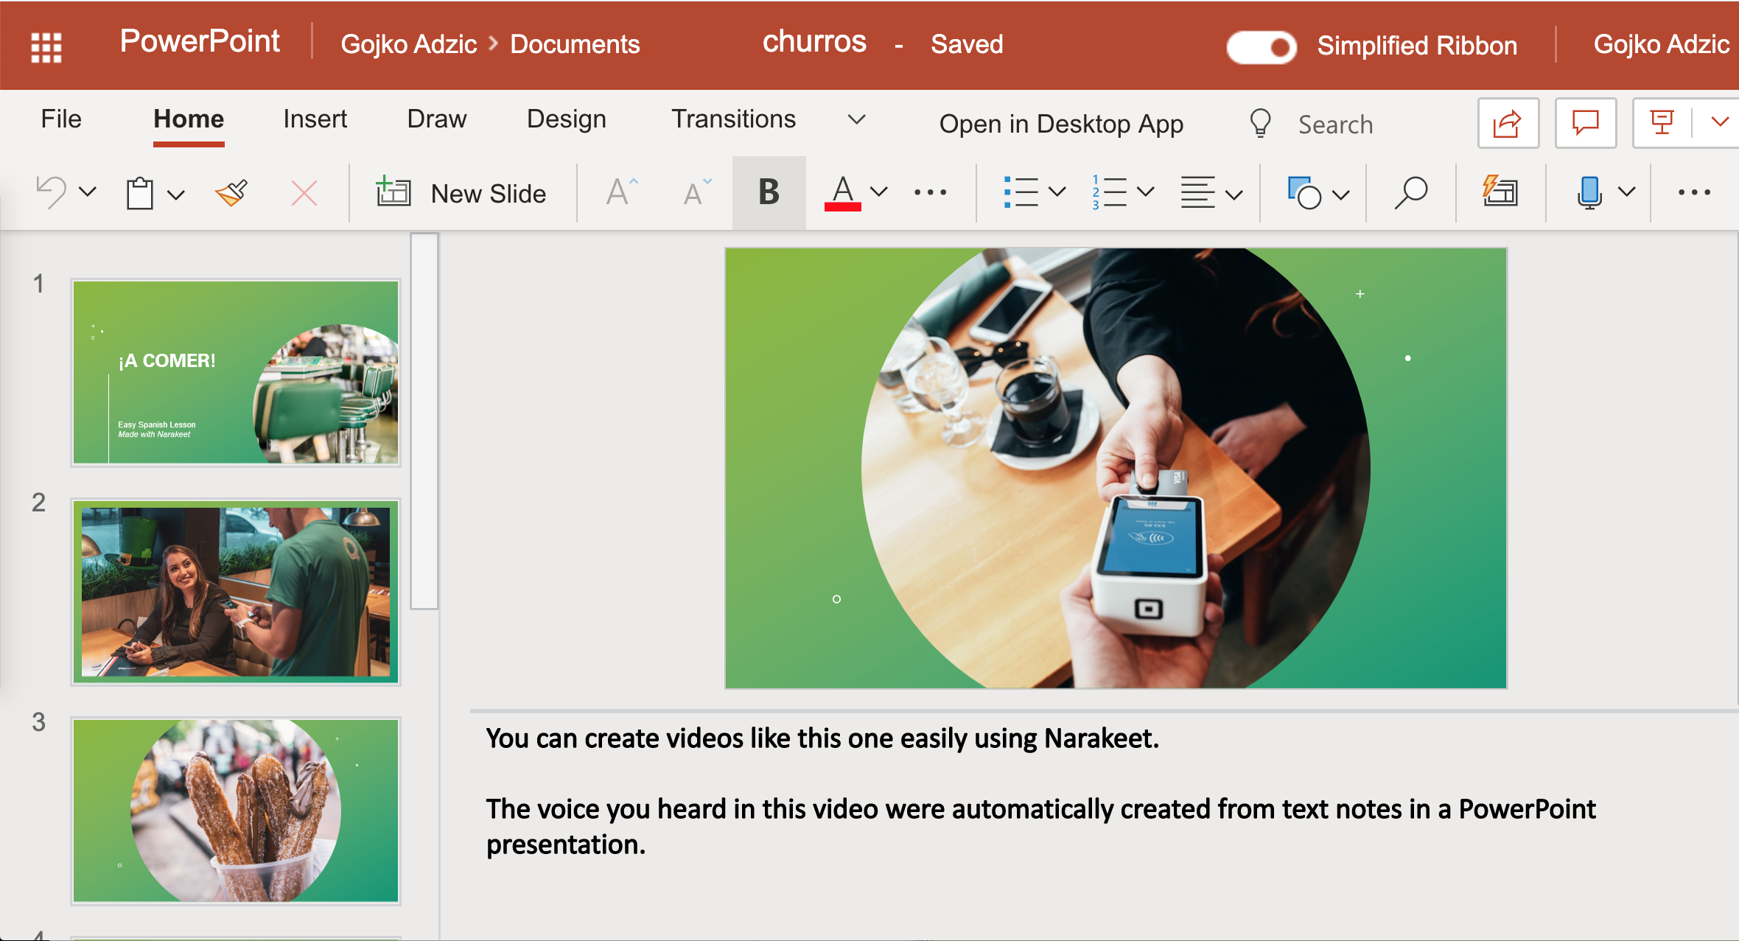
Notes:
You can create videos like this one easily using Narakeet.
The voices you heard in this video were automatically created from text notes in a PowerPoint presentation.

Slide 7
Turn slides into narrated videos!
Add
1
Add narration text into presenter notes
Upload
2
Upload PowerPoint to Narakeet.com
Download
3
Download your MP4 video
Notes:
Turn your slides into narrated videos in three simple steps.
Stop wasting time on recording audio, synchronizing picture with sound and adding subtitles.
Let Narakeet do all the boring tasks, so you can focus on the content.

Slide 8
20+ languages, 100+ voices
Notes:
Engaging language lessons are easy to create,
with a choice of more than 100 voices speaking more than 20 languages.

Slide 9
Narakeet.com
Notes:
For more information, check out Narakeet.com
(pause: 2)

