Slide 1
Pythagorean Theorem
Easy Geometry Lessons
Made with Narakeet
Notes:
(duration: 3)

Slide 2

Notes:
The Pythagorean Theorem shows how to calculate the distance between any two points on a grid.

Slide 3

Notes:
It explains the relationship between the sides of a right triangle.

Slide 4
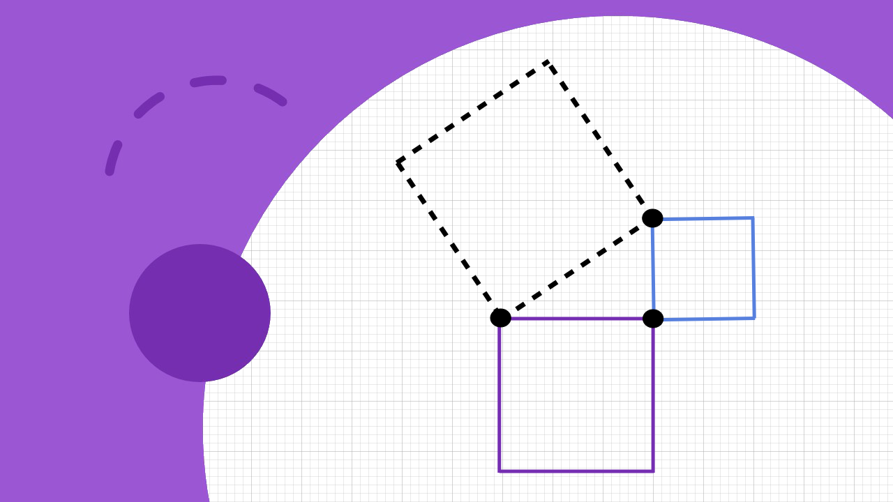
Notes:
Imagine drawing a square on each of the three sides.

Slide 5

Notes:
The Pythagorean theorem states that the area of the square opposite the right angle is equal to the sum of the other two areas.

Slide 6
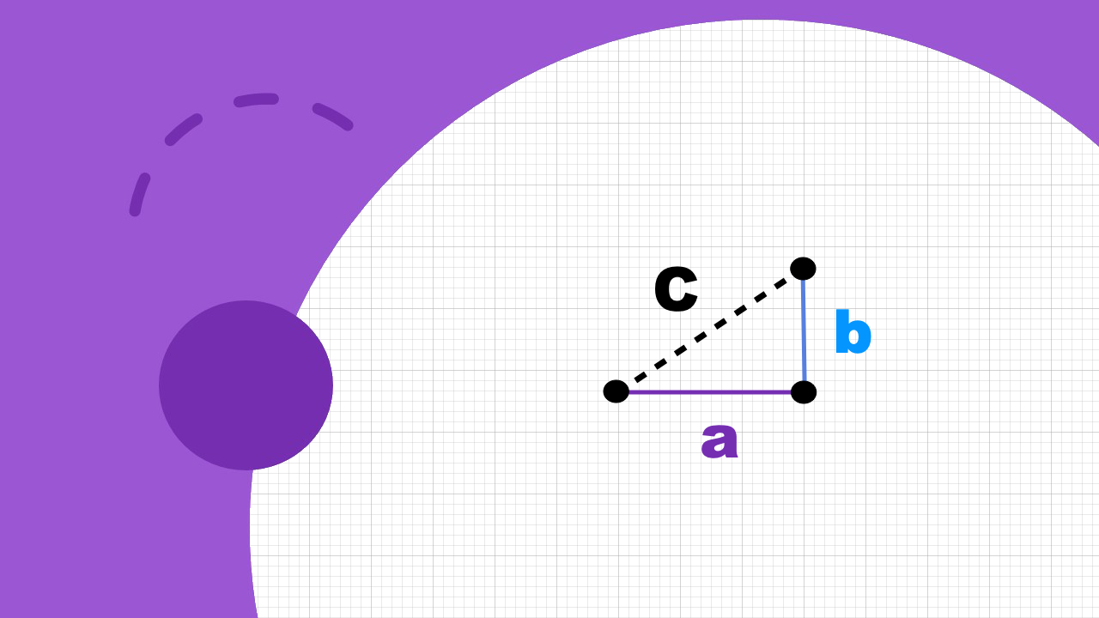
Notes:
The lengths of the A and B sides are easy to measure on a grid. The Pythagorean theorem allows us to calculate the length of the C side accurately.

Slide 7
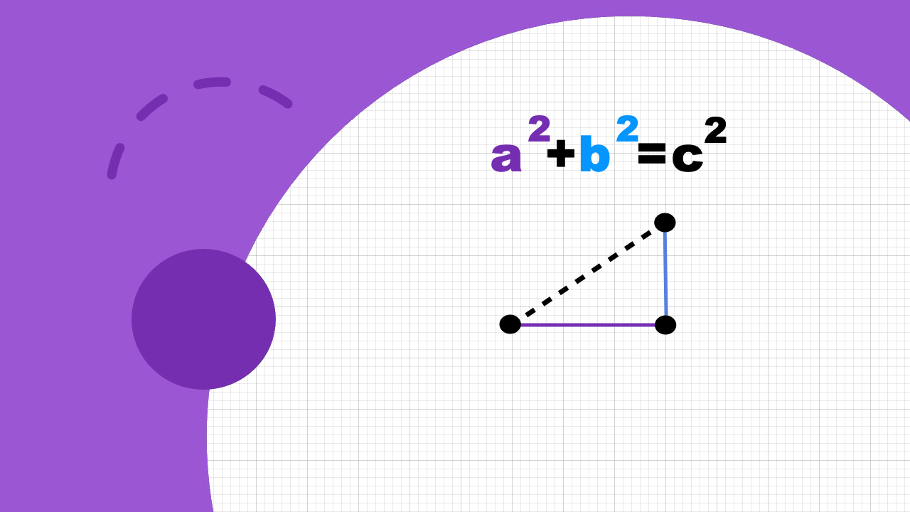
Notes:
The square of C is equal to the square of A plus the square of B.

Slide 8
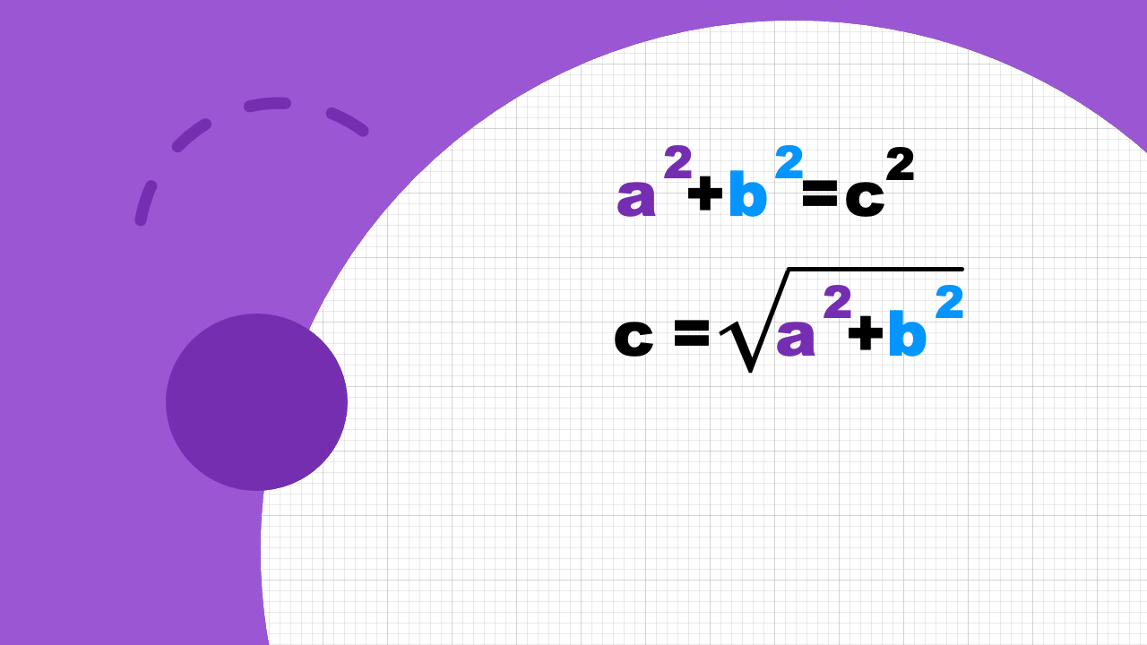
Notes:
Or to write this another way, the length of the hypotenuse is the square root of the sum of the squares of the other two sides.

Slide 9
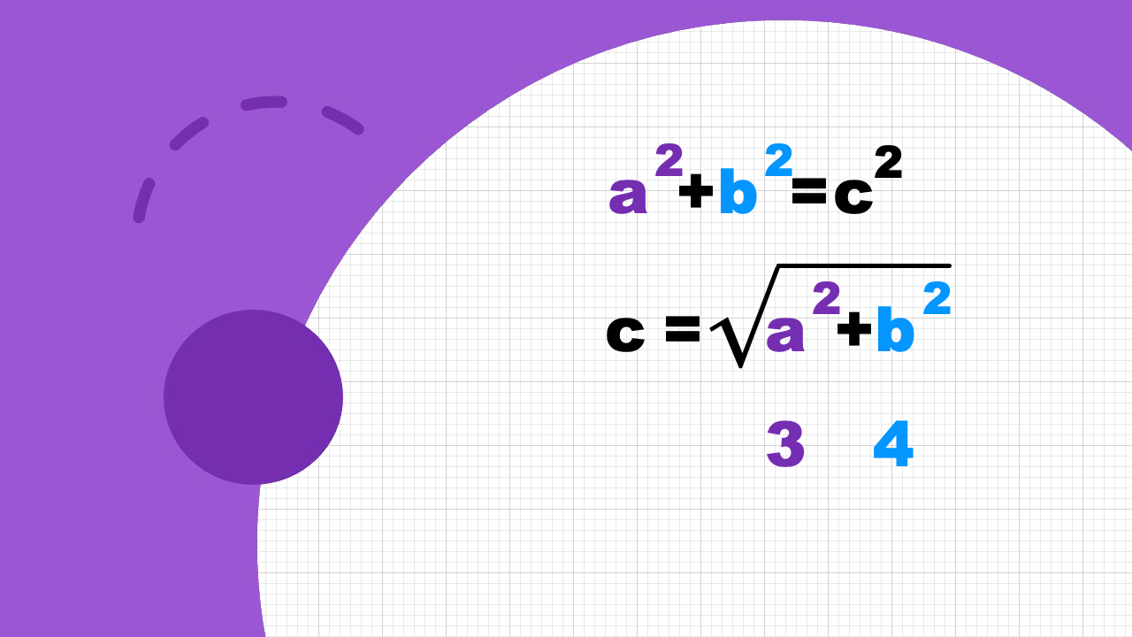
Notes:
For example, if the two sides next to the right angle are 3 and 4 centimeters long,

Slide 10
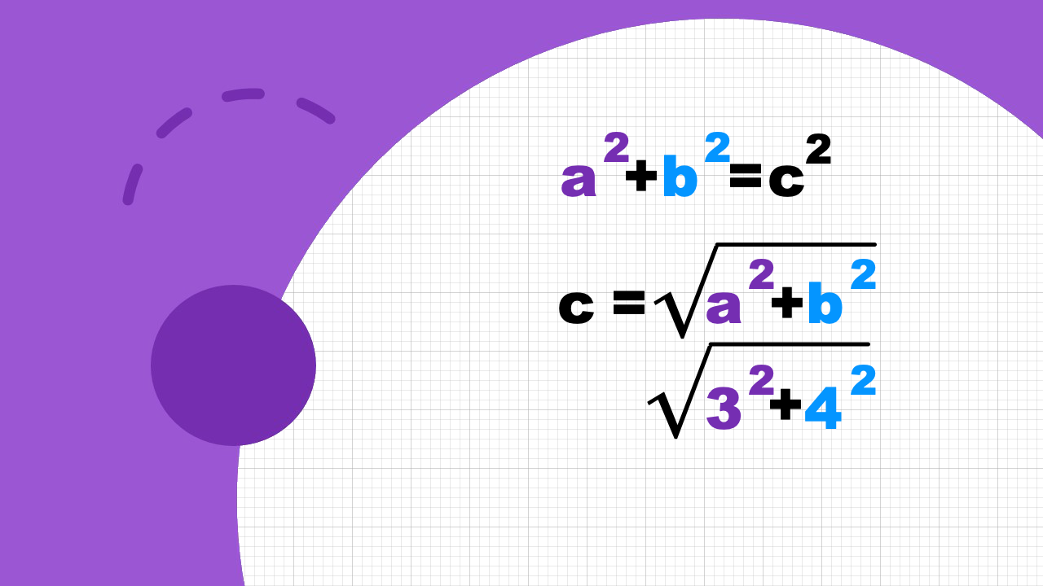
Notes:
We can find the length of the third side by squaring the other two lengths, adding them and calculating the square root.

Slide 11

Notes:
3 squared is 9, 4 squared is 16.

Slide 12

Notes:
Together they are 25.

Slide 13
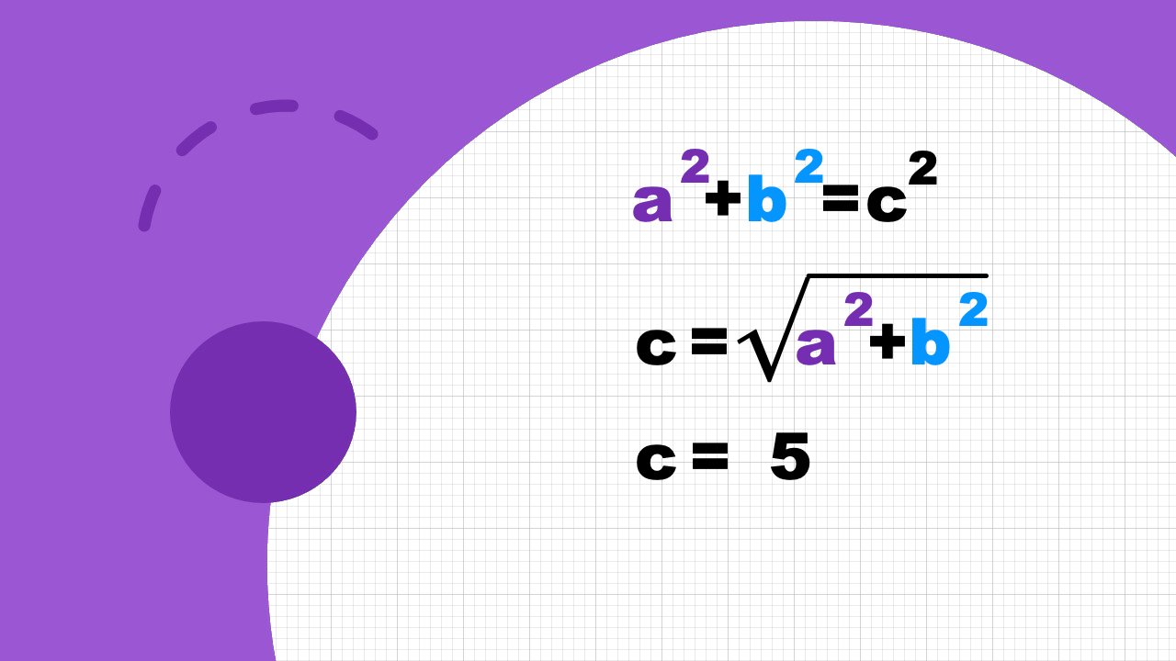
Notes:
So the hypotenuse is 5 centimeters long.

Slide 14
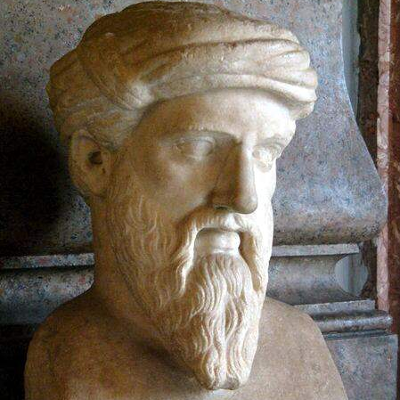
Pythagoras
(570 – 495 BC)
Notes:
The theorem is named after Pythagoras, one of the most influential ancient Greek mathematicians.
(pause: 1)

Slide 15
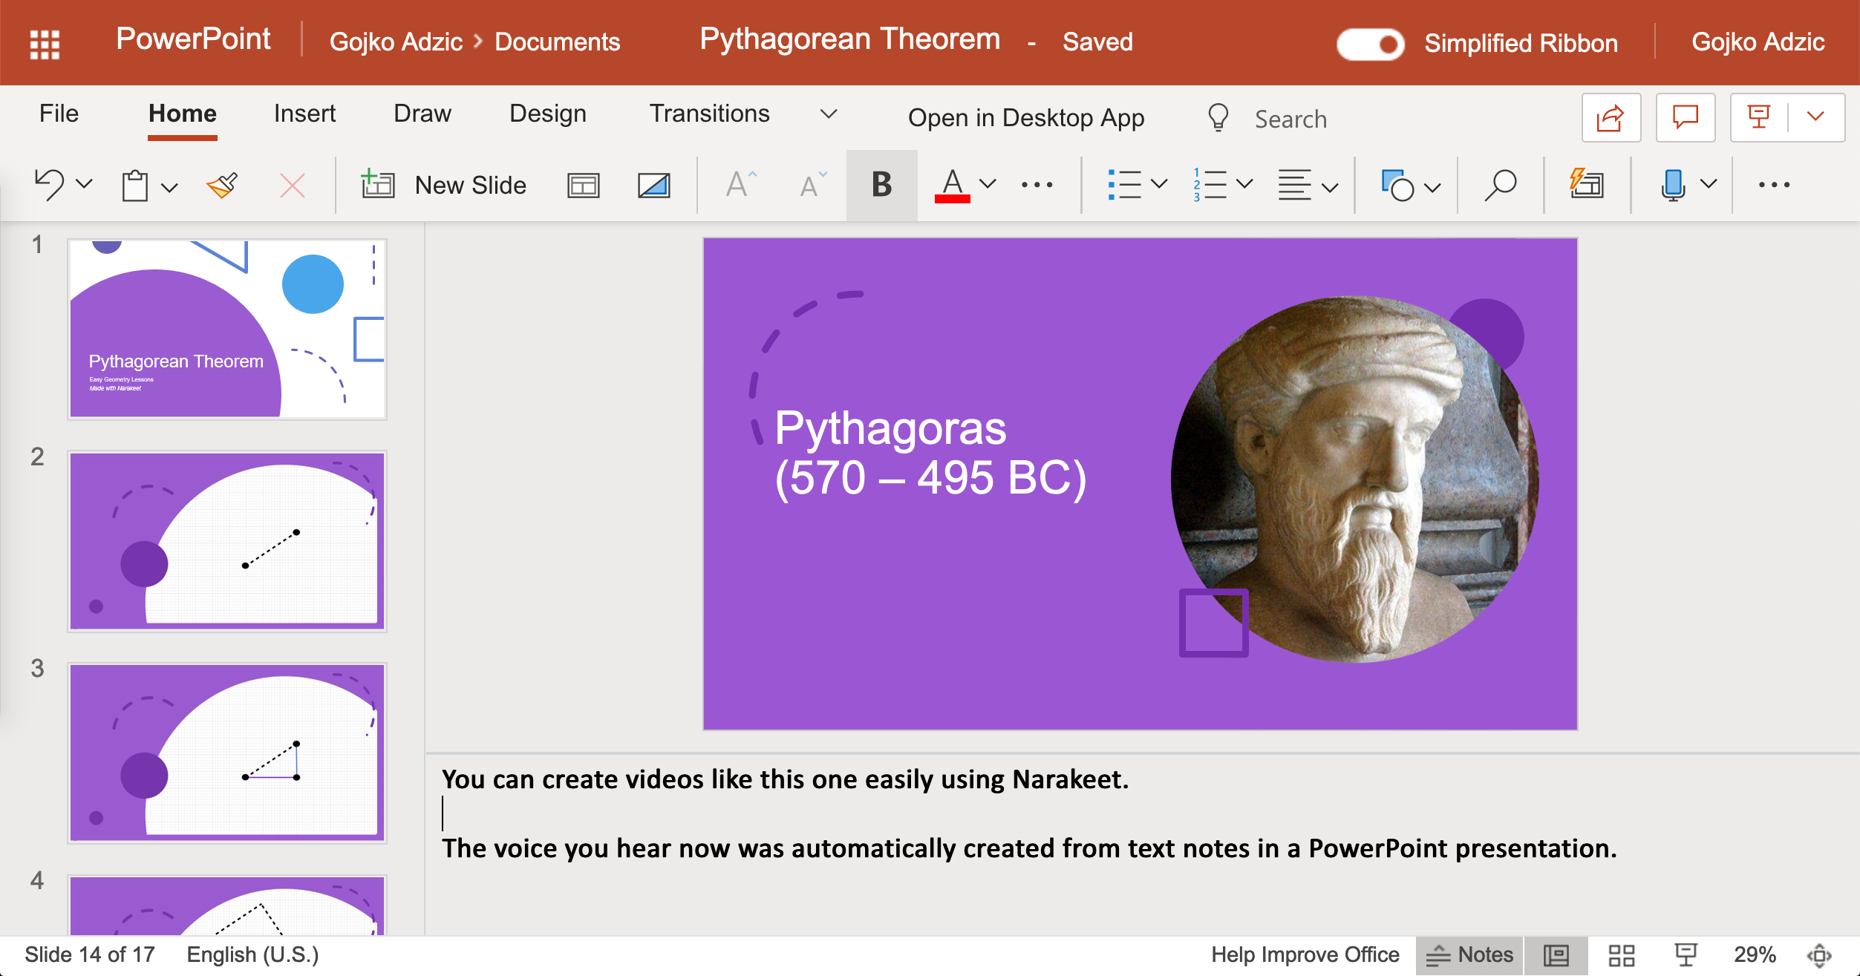
Notes:
You can create videos like this one easily using Narakeet.
The voice you hear now was automatically created from text notes in a PowerPoint presentation.

Slide 16
Turn slides into narrated videos!
Add narration text into presenter notes
Upload PowerPoint to Narakeet.com
Download your MP4 video file
Notes:
Turn your lecture slides into narrated videos in three simple steps. Stop wasting time on recording audio, synchronizing picture with sound and adding subtitles. Let Narakeet do all the boring tasks, so you can focus on the content.

Slide 17
Narakeet.com
Notes:
For more information, check out Narakeet.com
(pause: 2)

