Slide 1


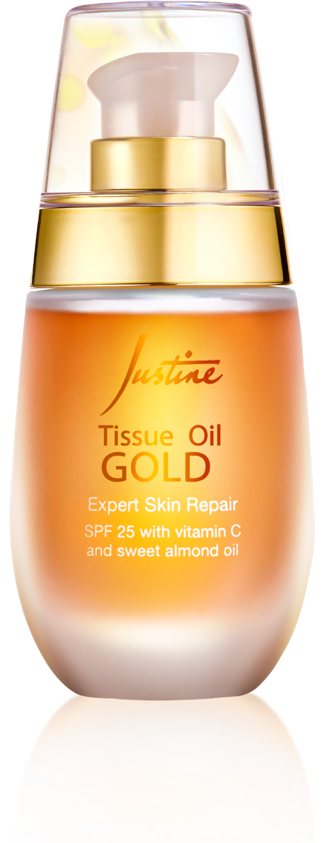
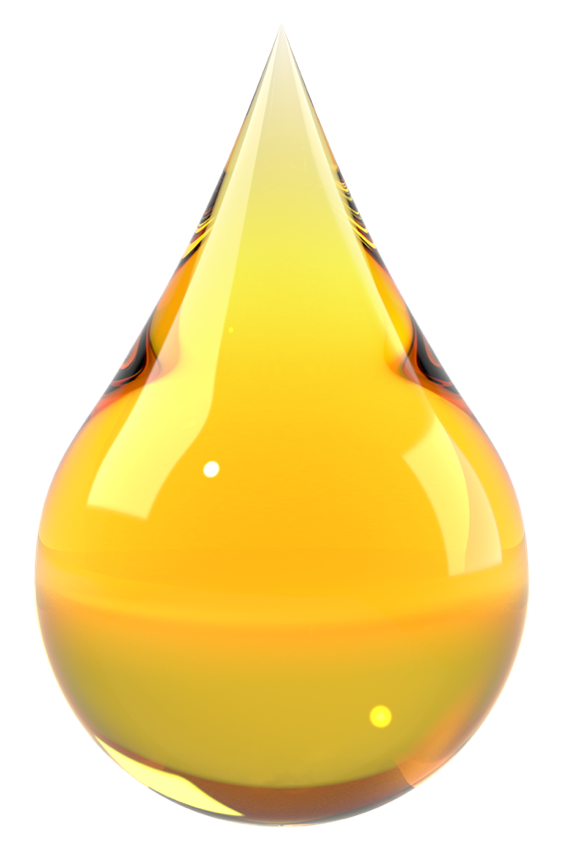
Notes:
(duration: 2)

Slide 2
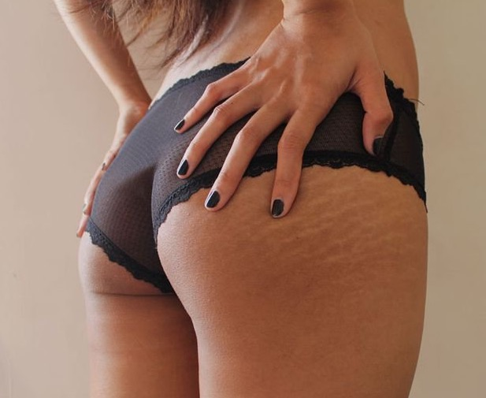
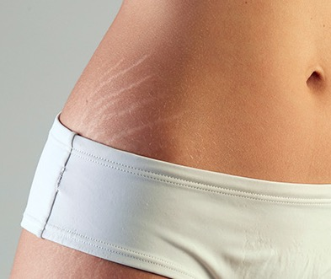
Notes:
Does your skin suffer from stretchmarks?
(transition: 1)

Slide 3
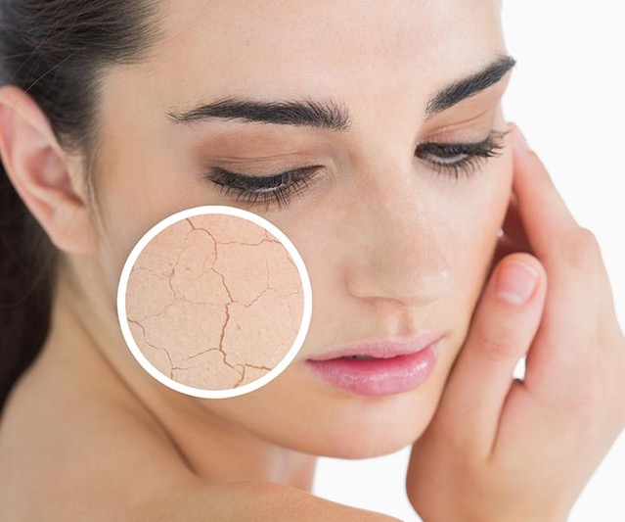
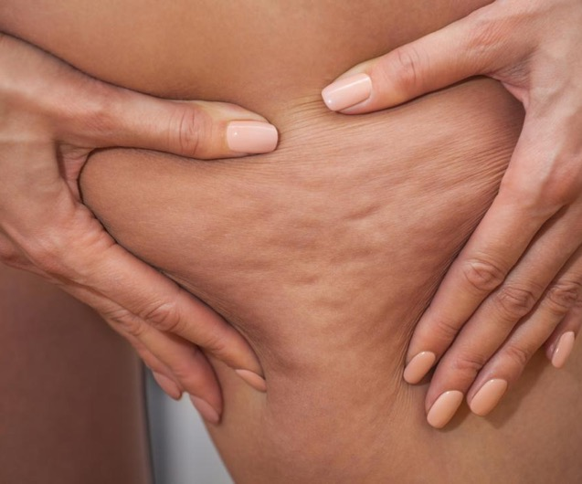
Notes:
(transition: 0.2)
dehydration

Slide 4
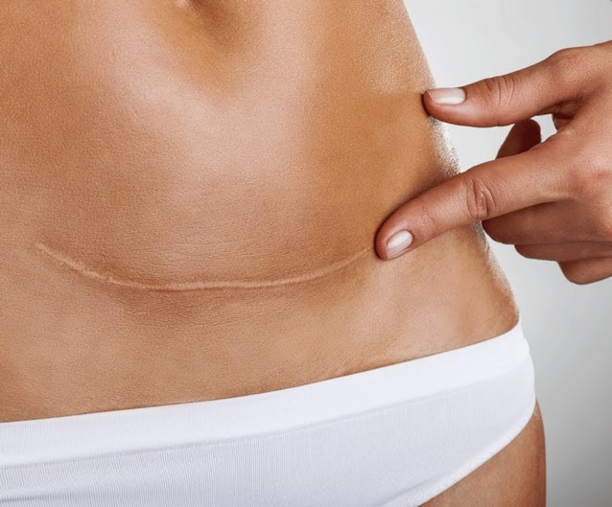
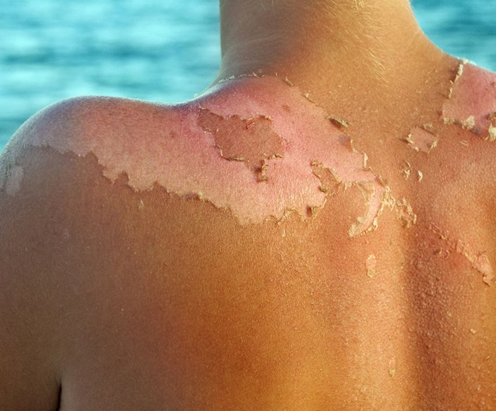
Notes:
(transition: 0.2)
or damage caused by sunburn?

Slide 5

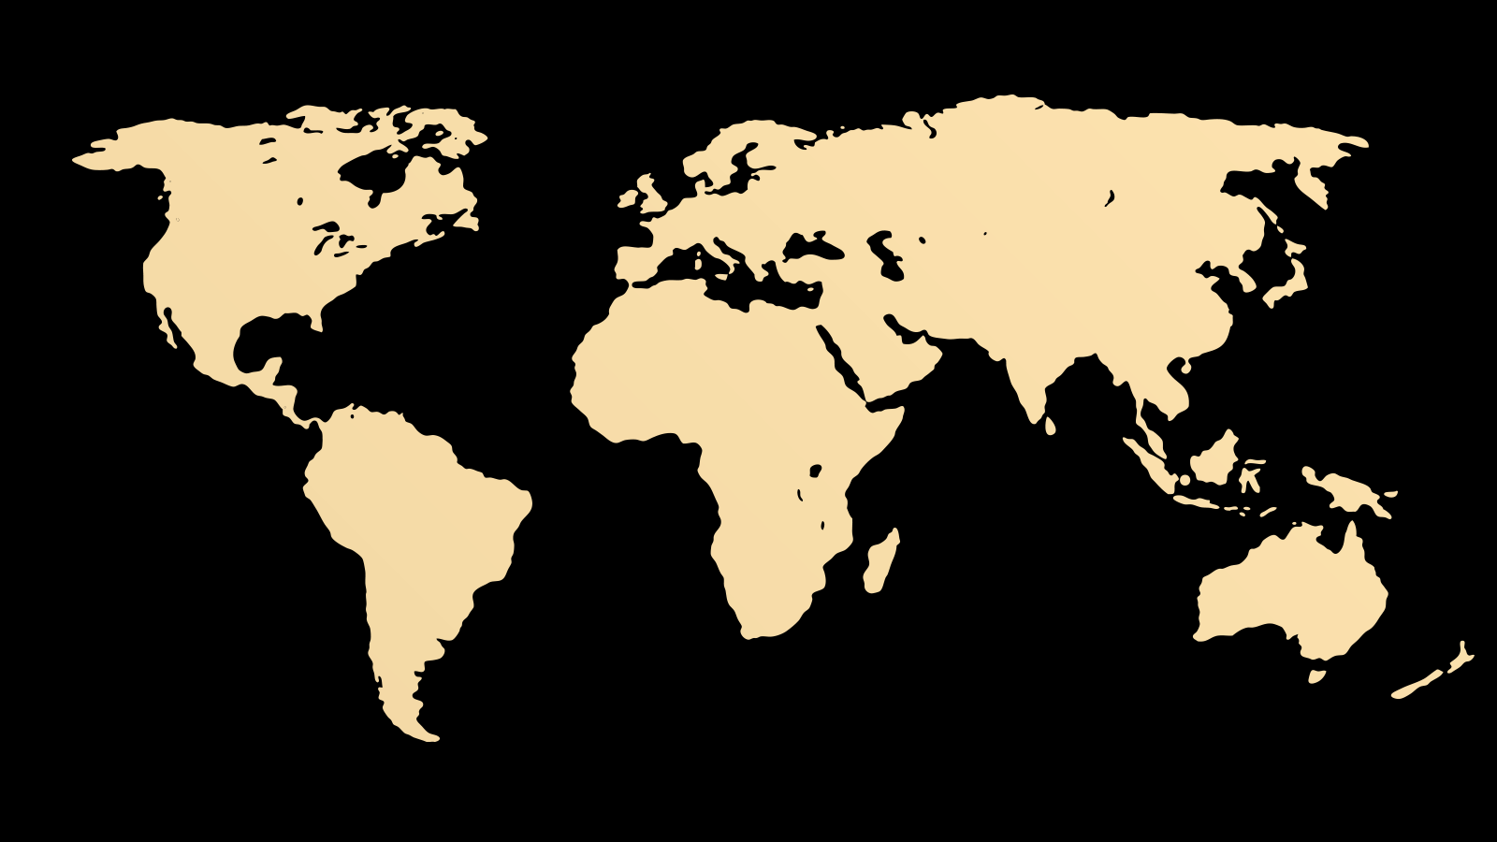
Notes:
(pause: 0.2)
(narration-mode: fragment)
Looking for the best solution to these problems

Slide 6

Notes:
we reached the south of Africa.

Slide 7
Notes:
(pause: 0.2)
**What’s the secret?**
(pause: 0.1)
(narration-mode: fragment)
We present to you

Slide 8
Notes:
**Justine Tissue Dermal Oil**

Slide 9

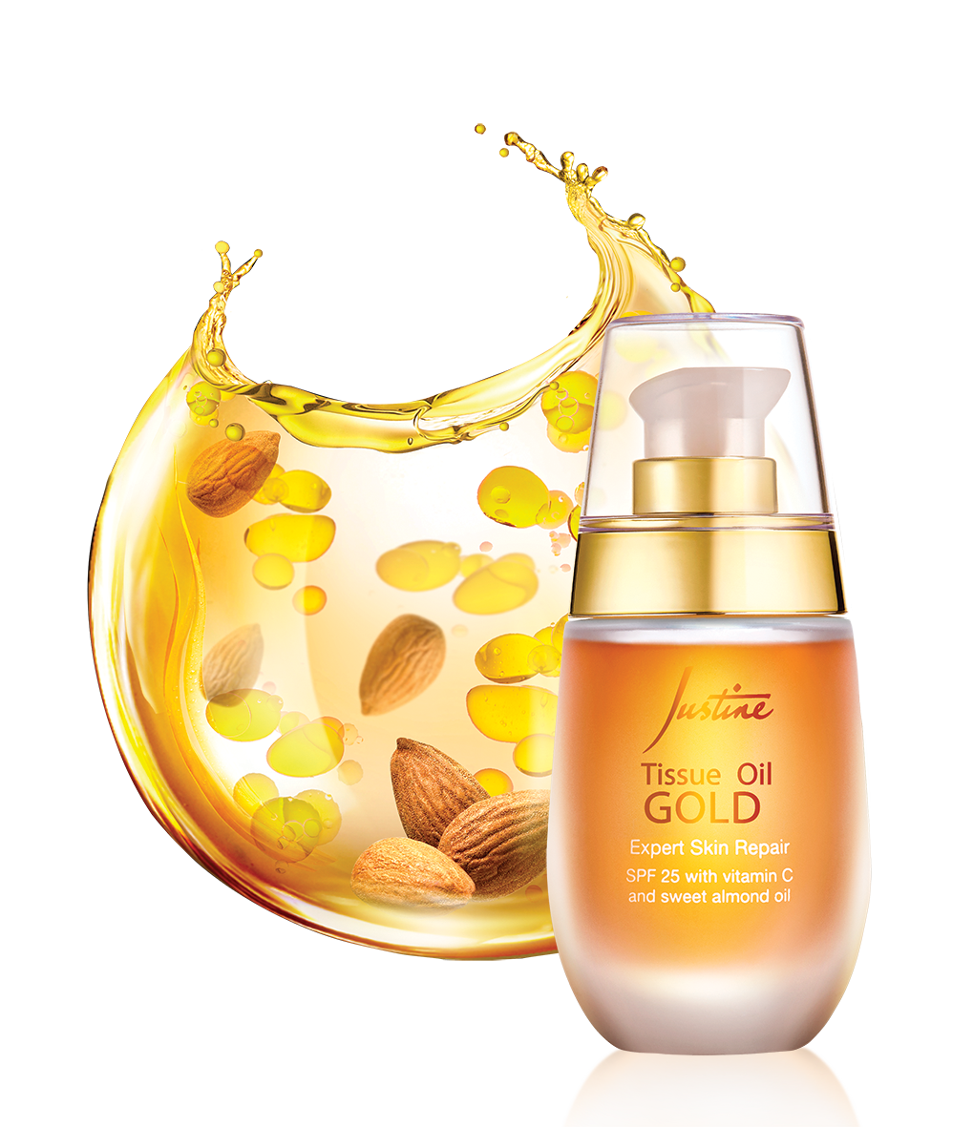
TOP SELLER
IN SOUTH AFRICA
FOR 10 YEARS!
Notes:
The best selling skincare product in South Africa for the past 10 years!

Slide 10

4 high-quality oils in one product
Notes:
(transition: 0.5)
It is made out of 4 completely natural ingredients.

Slide 11
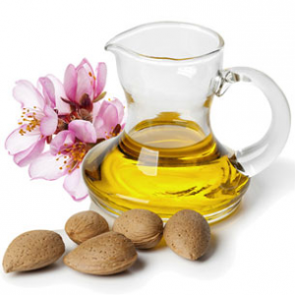
4 high-quality oils in one product
ALMOND
OIL
Notes:
(transition: 0.5)
Almond oil

Slide 12
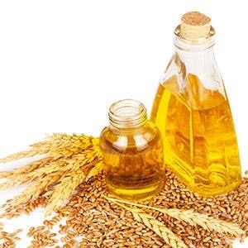
4 high-quality oils in one product
ALMOND
OIL
WHEAT GERM
OIL
Notes:
(transition: 0.5)
wheat germ oil

Slide 13
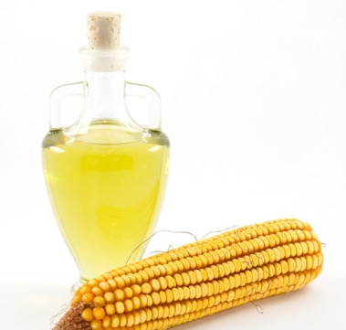
4 high-quality oils in one product
ALMOND
OIL
WHEAT GERM
OIL
CORN
OIL
Notes:
(transition: 0.5)
corn oil

Slide 14
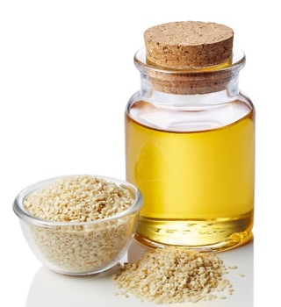
4 high-quality oils in one product
ALMOND
OIL
WHEAT GERM
OIL
CORN
OIL
SESAME
OIL
Notes:
(transition: 0.5)
and sesame.

Slide 15
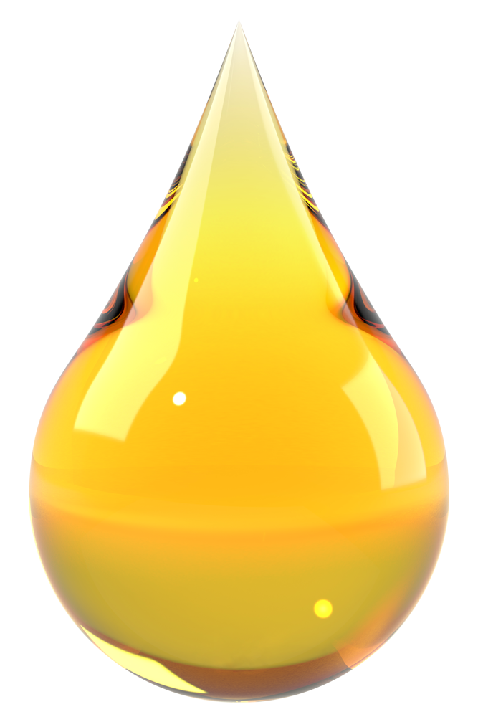


2 times
a day
Notes:
(transition: 0.3)
Use it twice per day!

Slide 16
2 times
a day
28 days
Notes:
You will see the results in just 28 days!
(pause: 1)

Slide 17
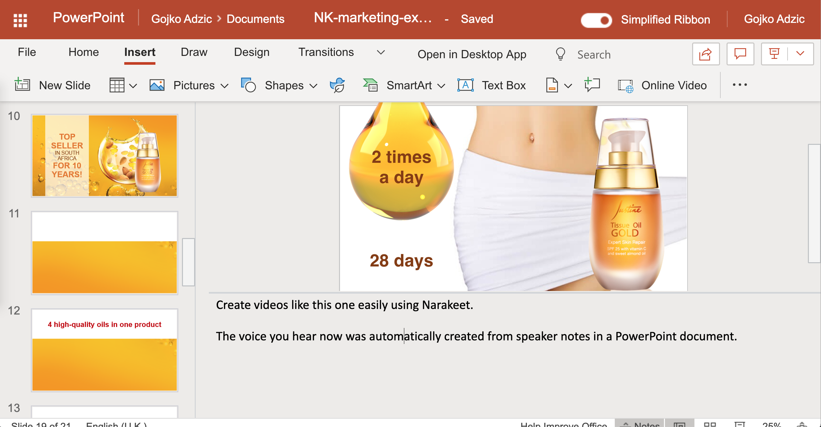
Notes:
(voice: rodney)
Create videos like this one easily using Narakeet.
The voiceover you heard was automatically created from speaker notes in a PowerPoint document.

Slide 18
Turn slides into
Narrated Videos
​1. Add narration text to speaker notes​
2. Upload file to Narakeet.com​
3. Download your MP4 video
Notes:
Turn your slides into narrated videos in three simple steps. Stop wasting time on recording audio, synchronizing picture with sound and adding subtitles. Let Narakeet do all the boring tasks, so you can focus on the content.

Slide 19
Narakeet.com
Notes:
For more information, check out Narakeet.com
(pause: 3)

